Slide 1

How to use ‘Emotion Coaching’ with your child!
An exploration of techniques, strategies and phrases to use when your child is angry or upset

Slide 2

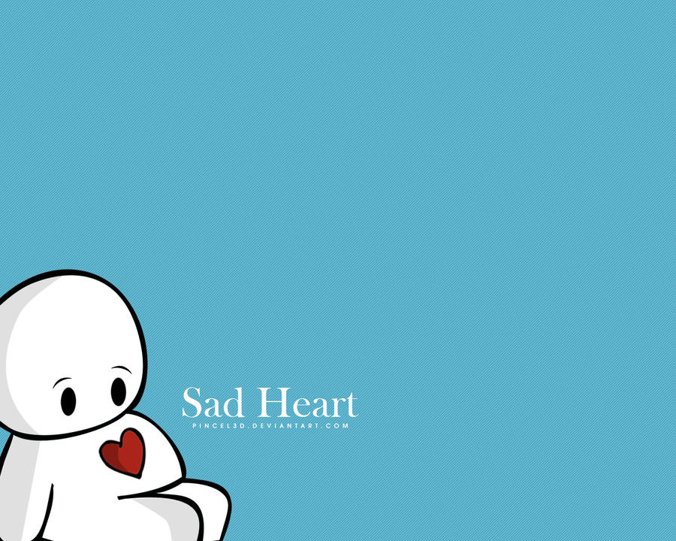
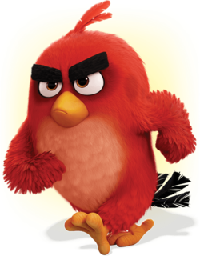

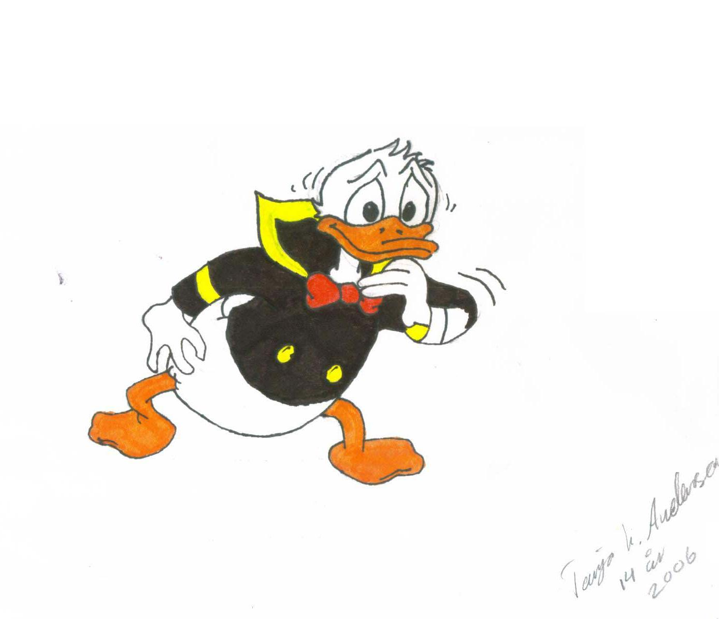
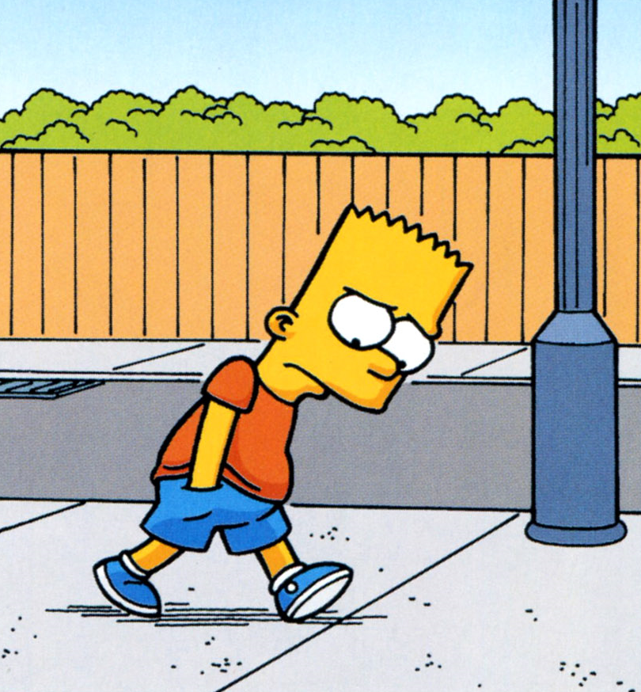
Response to our thoughts and feelings because of what is happening around us
Happy
Angry
Sad
Worried
Bored
Scared
Regulating our emotions is a skill
Notes:
We are all different so the same thing could happen to two people and yet they could both feel totally different emotions! For example, if a family member is having a baby one person might feel very happy and another might feel worried about the change.
Some of us learn to regulate our emotions as we grow up. For example, when a child spills their drink they may be distraught, but as they grow up they no longer become upset by this and instead learn to pick up the cup, clean up the mess and get a new drink. We are all different so some people find it easier than others to regulate their emotions. It is also important to remember that at times everyone struggles to manage their emotions!

Slide 3
Parent’s view
‘Sometimes my child’s emotions take me by surprise. Things that haven’t caused a huge reaction before are suddenly very hard to handle.
For example when Dad left for a business trip saying goodbye was unexpectedly hard. At this particular time he fell down and though he wasn’t badly hurt, it was the last straw — on any other occasion he would have just stood up and brushed himself off.
That wave of emotion comes out of him and it catches me off guard. Maybe it’s because I expected him to be able to handle it.’

Slide 4
If a child is upset, it can sometimes be a trigger for the adult to become upset too! So this can lead to a situation of reacting to the emotion rather than responding to the child’s needs.
“In these moments when my child’s feelings are big and his reactions intense, I find myself being more dismissive of his emotions than I intend to be. I tell him; “you’re okay” or “shake it off” or “calm down.”
It can often be the case that when a child is upset and needs an adult the most this is the exact moment we are not necessarily prepared for. This is likely to be due to our own tiredness and stress.
“I feel like my words fail me — I search for the right thing to say and it escapes me.

Slide 5
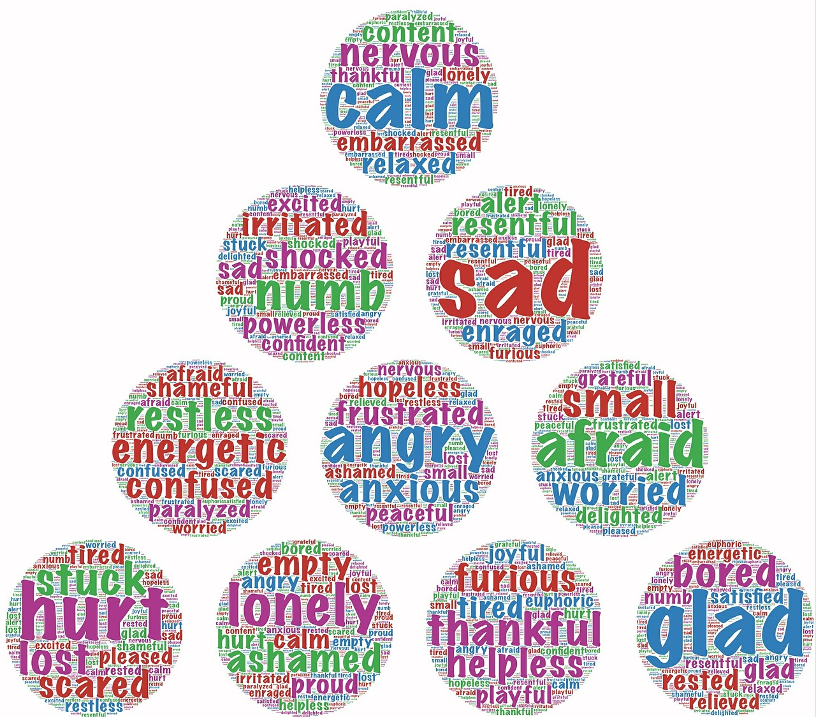
Coach your child through their feelings
It is possible to lead your child from experiencing those feelings to expressing them.

Slide 6
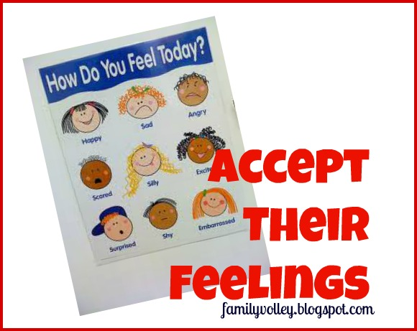
‘It’s okay to be upset — it’s good to let it out.’
As your child’s emotion-coach, the first thing you want to teach them is that emotions are meant to be experienced, in fact, that their emotions need to be felt.
By doing this you are both acknowledging how they feel, validating that feeling, and showing that the emotion itself, even negative emotions, are not something to be feared or avoided.
‘It seems like you are cross, it’s okay to be cross. It’s good to let that anger come out.’
‘Your face/body looks sad. It’s okay to feel sad. It is sad to say goodbye.’

Slide 7
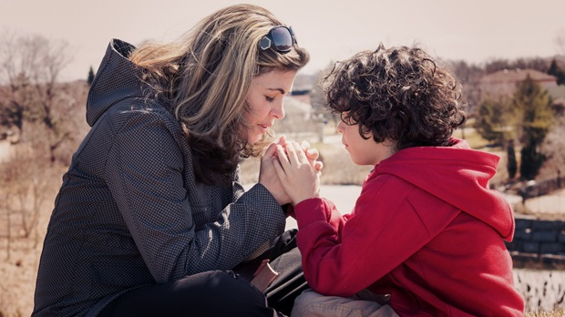
‘I’m here for you — When you are ready I will listen!’
It’s important to keep emotionally connected using a calm voice
‘I can see that you are upset, let’s sit here for a moment. I’m with you, I’ll stay with you — it’s okay to feel _______. I won’t leave you.’
The key is being able to separate your child’s emotion from their behaviour — sometimes what we inadvertently do is see the behaviour we want to change and inadvertently dismiss the emotions.

Slide 8

“It’s okay to feel how you feel. It is not okay to _________.” “Use your kind hands/words.”
Sometimes it is necessary to use a very clear limit in how our children express their emotions. It isn’t the emotion itself that needs to change, but rather how they are expressing it.
‘You look like you are really, really angry. It is okay to be angry. It is not okay to hit. I will keep you safe. Let’s go and play on the trampoline, go for a walk, go to your bedroom.
This is a very clear statement — hitting is not okay. As your parent, I will keep you safe, I will help you regulate your anger, being angry is okay, hitting is not okay.

Slide 9

‘How you feel right now won’t last forever. It’s okay to feel how you are feeling. It will pass and you will feel better again soon.’
In-the-moment your child feels (and acts) as if their entire world is ending. Their emotions are big and overpowering and they feel that they will never feel better again — which only compounds how they feel.

Slide 10
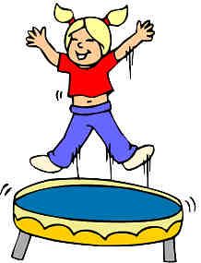
Taking a break when we are angry, walking away for a moment is a good way of regulating anger.
You are teaching your child to give themselves a little space to breathe and time to process what has happened.
“I can see you are really upset about this. It’s okay to be upset. It doesn’t seem like what I am saying is helping. You remember what to do when you’re upset, and you remember how to calm down. I’ll be over here when you need me.”
After taking a break you can coach your child through their anger and help them find a better way to solve their issue/frustration.
‘What happened? What were you thinking? How did this make you feel? What can you do next time you feel this way?’

Slide 11

Modelling
A good way to build your child’s emotional intelligence is to model and describe how emotions feel to you. As you talk, they may relate or change what you say with their own descriptions.
‘When I feel that upset, I feel like I can’t catch my breath, so I try to breathe slowly. Sometimes I feel a little embarrassed too, and a little hurt, I feel like my heart is a bit bruised. After a few minutes, my heart feels better and I feel like I can go on with my day.’
Using visuals that will help them identify their emotions is powerful. Emotions are abstract and children, even adults, find it hard to describe them.

Slide 12
Happy
Angry
Scared
Sad
Worried
Bored

Slide 13
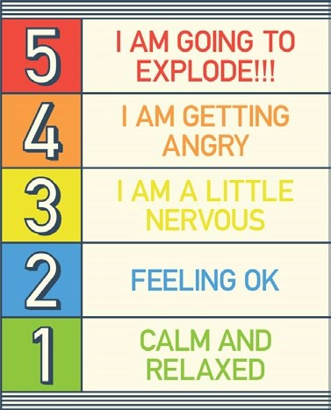

Slide 14
Regulate
Get close
Make eye
Listen
yourself
contact
Be curious and seek to understand
Listen
Offer warm
Show
again
affection
empathy
(
with consent
)

Slide 15
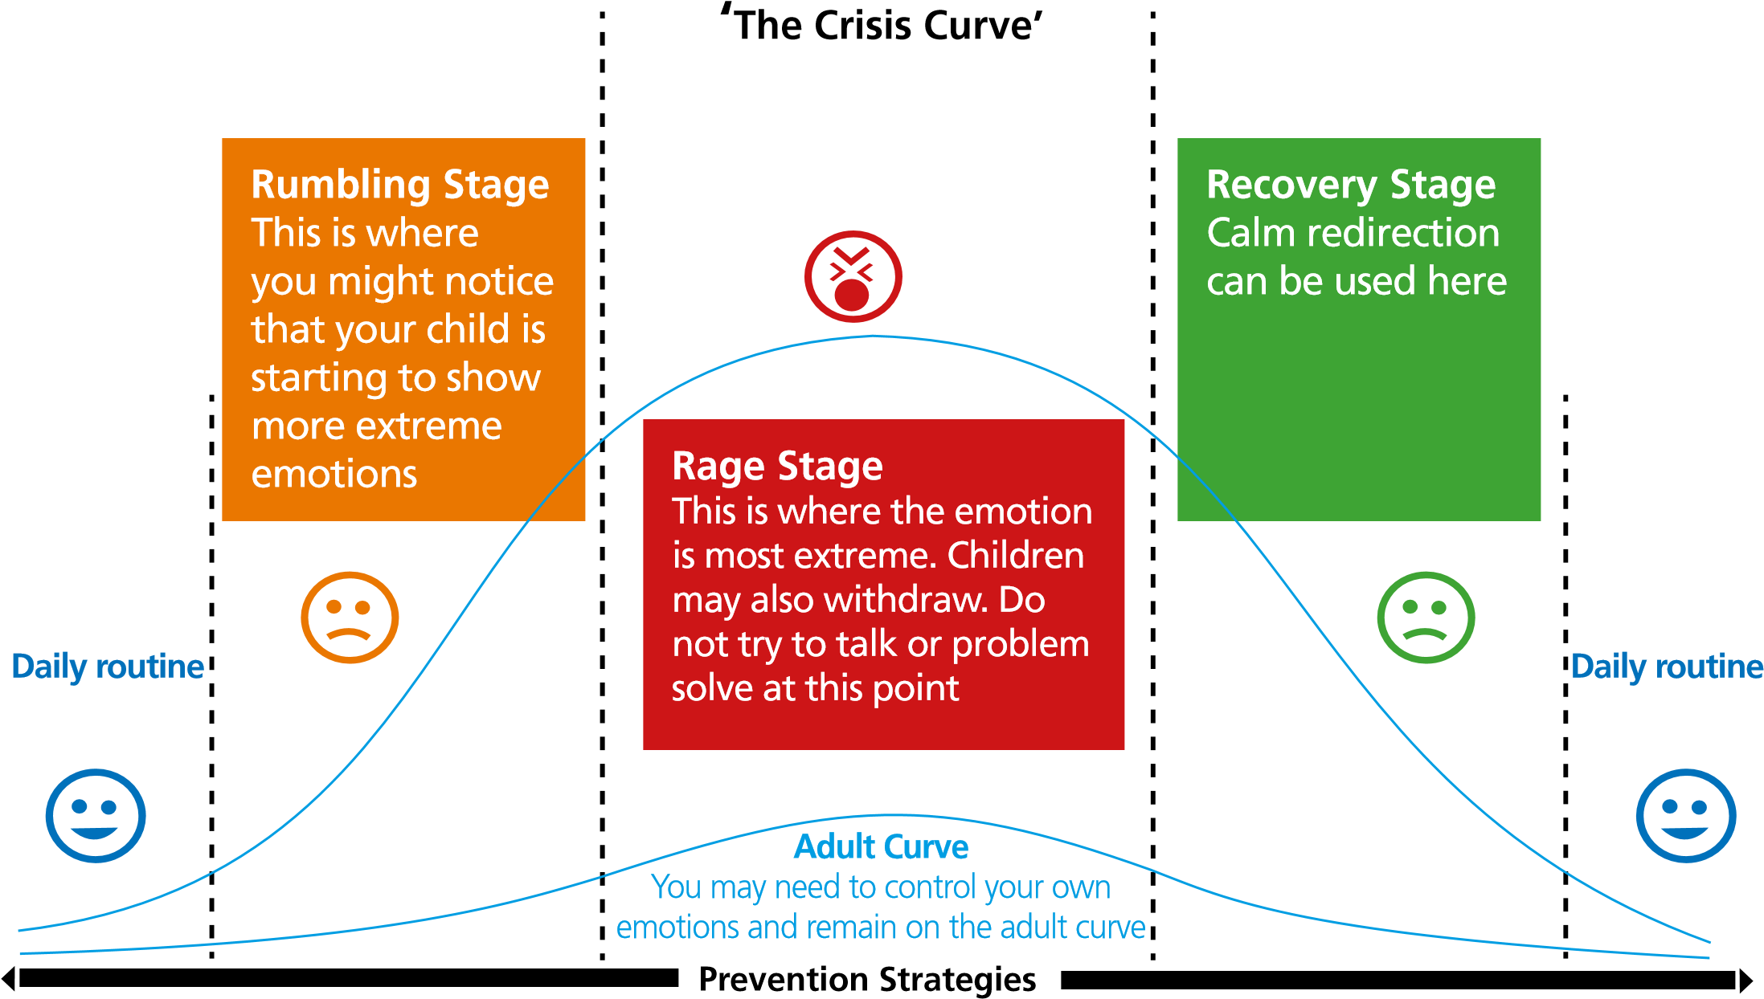

Slide 16

You are good and kind.
Being dysregulated is not being bad or naughty. Being angry or frustrated is not being bad. Yet, sometimes when we are emotional, we don’t always make the best choices.
‘You were angry. You didn’t mean those unkind words about your brother. Sometimes we say things we don’t mean when we are cross. You are a kind person. What do you think would make your brother feel better?’
This also helps our children with their friendships..
Notes:
They may label another child as “bad” because of something that child did — maybe it was impulsive — maybe they didn’t think before acting — maybe they were emotional and made a bad choice — but they are not “bad.”
This is an important distinction to learn in early childhood

Slide 17
Let’s start again!
Situation: You’ve planned a fun activity. You are so excited!! You are trying to get everyone out the door — emotion and excitement are high. Something happens — now your partner is upset — your child has acted up — the children are fighting and you are so disappointed.
‘Whoa!!! Stop!!! This is not the fun we had planned for today! This is not fun for anyone. Everyone stop! That was not the way to handle that situation, was it? She didn’t mean to hit you in the eye with her coat sleeve and you know it’s not okay to hit ever. Let’s start again!! Let’s try it all again!! How can we do it better this time??

Slide 18
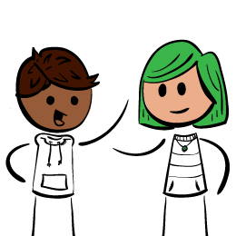
Through our mistakes we grow
This is not just true for academic situations or achievements. It is true for relationships, for friendships, for dealing with hard social situations.
It is true of things that make us feel sad, things that make us doubt ourselves.

Slide 19
Rumbling Stage
Stay calm
Talk quietly
Take deep breaths
Stay close (if your child likes or wants this)
Avoid conflict
Don’t get into a battle for power
Be empathetic and understanding
Use some of the suggested strategies
Attempt to distract or redirect your child
Be flexible; your child may not be able to.

Slide 20
Rage Stage
Protect your child and others from harm
Don’t punish
Don’t take your child’s behaviours personally.
Remove any witnesses.
Be aware of your body language.
Avoid conflict
Remain calm.

Slide 21
Recovery Stage
Be aware that your child could go back to the Rage Stage
Give your child time to become calm
Offer gentle redirection and distraction
Use calming and relaxation strategies
Allow sleep
Be aware that your child may become upset, embarrassed, and want to say sorry.
Do not talk about the rage behaviours at this time unless your child wants to

