Slide 1
Reading in Year 3 and 4

Slide 2

Aims/Objectives
Why are we here?
The importance of reading
How we teach reading in school – Guided Reading, Class Libraries, High Quality Class Texts
The Accelerated Reading Program
Relevant information for Year 3
Progression in reading in Year 4
How you can support reading at home

Slide 3
Learning to read, reading to learn …
Read on get on campaign (Save the children) https://www.youtube.com/watch?v=Orb6xXPPBKo&feature=youtu.be
How you can promote a love of reading:
There’s no app like a lap … model good reading practices – invite your child to read a recipe as you bake, read the TV guide to you before choosing a programme.
Visit the library. Comics are a good reward – weekend treat.
Buy books or book tokens for birthdays and as gifts.
Encourage your children to swap books with their peers.
Have a family/their own bookshelf of favourite books.
Always have a book handy – on a plane, on a train, listen to stories on CDs in the car.

Slide 4
Guided Reading
VIPERS – vocabulary, inference, predict what will happen, explain, retrieve information, sequence events from the text.
When do we do it? Part of the English lesson.
What are the benefits? Enriching vocabulary – language collected on Writing Wall and in Reading Record Books.
Fluency – what does it mean?

Slide 5
The Accelerated Reader Program
the STAR reading test
your child’s ZPD
the Reading Books
the Accelerated Reading Book quizzes

Slide 6
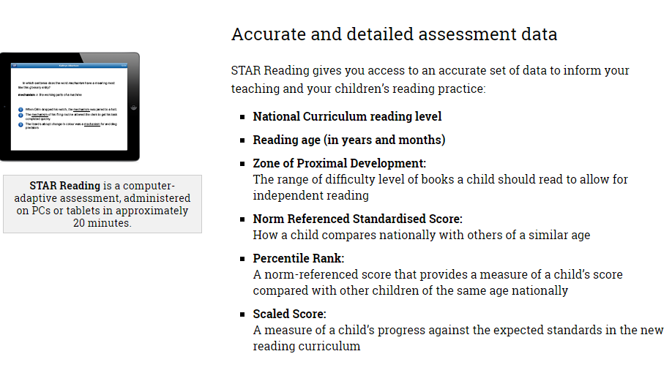

Slide 7
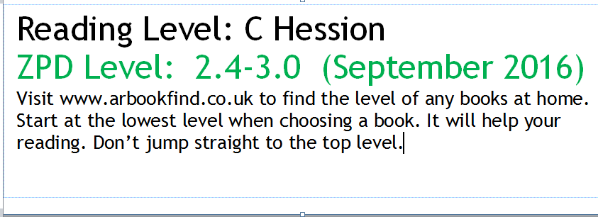
Stickers added to Reading Record Books every half term

Slide 8
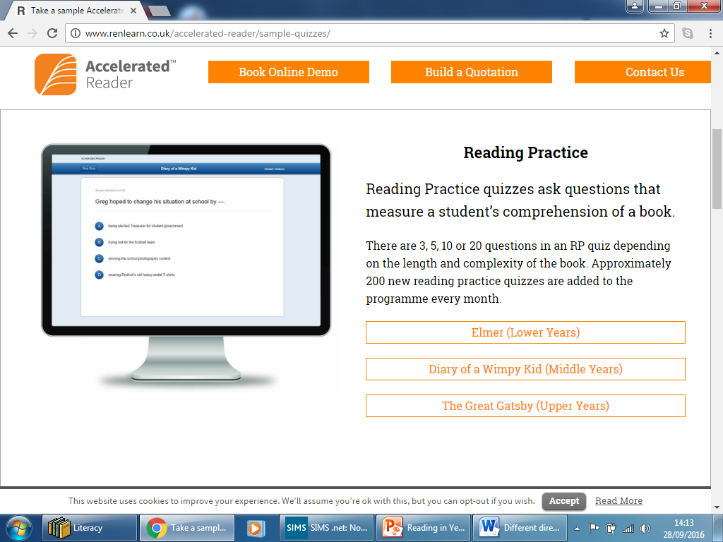

Slide 9
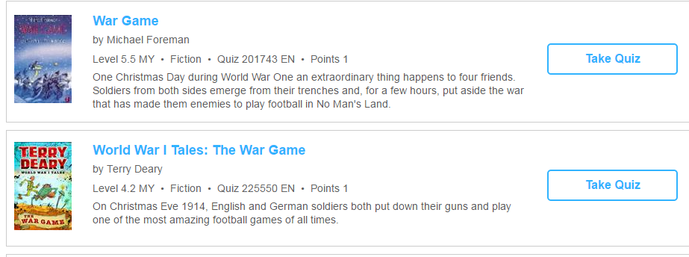

Slide 10
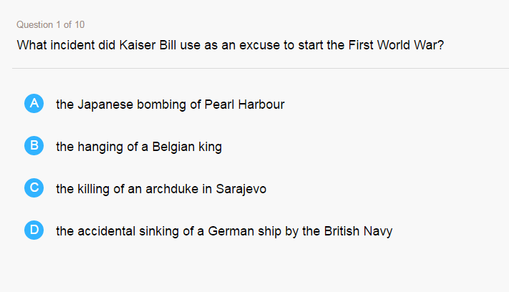

Slide 11
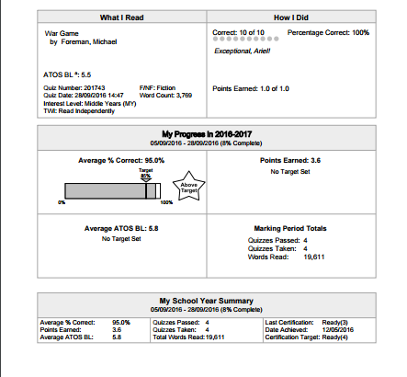
Children can print off a TOPs report to share with parents

Slide 12
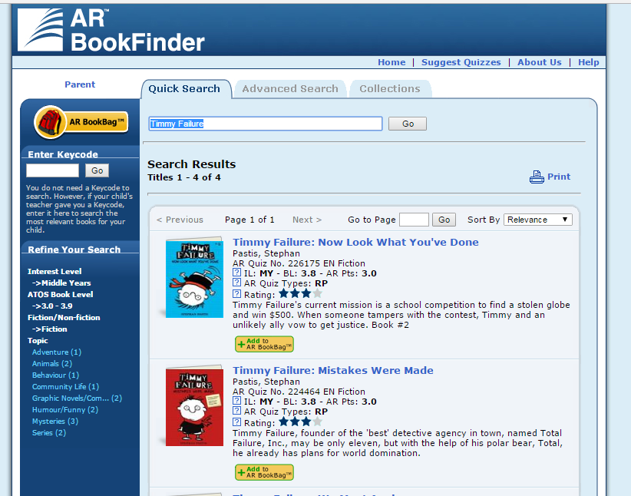
Use AR Book Finder to look up reading books which have a quiz at home

Slide 13
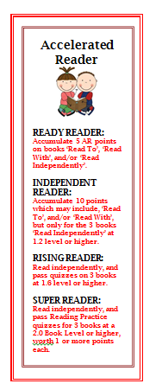
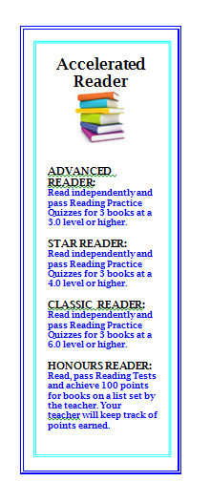
Book Marks which show progression through the different certification levels.

Slide 14
Relevant information for Year 3
Continue to read with your child
Paired reading. You read a page to help get them into more complex text.
Developing good reading habits – read little and often. 10 minutes a day is better than half an hour at the weekend.
Establish routines, same time and place to read together.

Slide 15
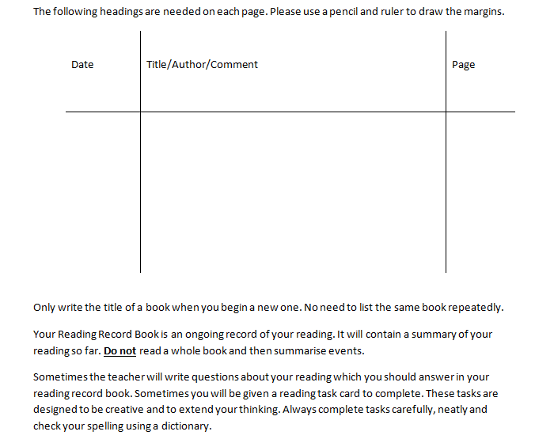
How to complete your reading record book:

Slide 16
Key Skills in Year 4
Skimming – to quickly identify the main ideas
reading key ‘signpost’ information: e.g. headings, subheadings
Using visuals / layout features
Reading the first and last sentences of paragraphs / sections
Think about the overall meaning of the text

Slide 17

Scanning – to find specific information
Know what questions / ideas you are trying to answer or respond to
Don’t try and read every word
Read vertically rather than horizontally
Visualise key words
Look for text clues – numbers, capital letters, length of words, punctuation, spelling patterns
Use signposts
Use layout / textual organisation features – e.g. sections or alphabetical order

Slide 18
Resources to support reading at home:
nosycrow.com
Nosy Crow is a prize-winning independent children's publisher based in the UK, storybook apps
https://ukla.org/news
United Kingdom Literacy Association – shortlists of books for their annual award. Descriptions of books on the website.
Stockport Book Awards – wider reading.
http://www.booktrust.org.uk/
http://www.lovereading4kids.co.uk/
www.laburnumhouse.co.uk/

Slide 19
Dates for your diary
World Book Day – In March each year
Author visits: Last year Gail Clarke and Sarah Holding
The Book Fair in November each year – how we use the 80% commission to put exciting new books in each class library.
The Reading Challenge:
A book that has won an award.
A classic novel.
A book that makes you laugh.
A book based on historical events.
A book of poetry/ short stories.
A book depicting a different culture.
A book that’s been made into a film.
A biography/autobiography.
A book set during a war.
A book based on a myth or a fairy-tale.

